Slide 1
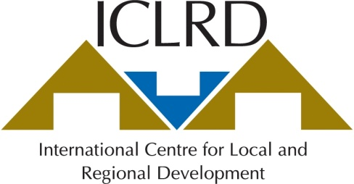
Local Government Reforms Announced, October 2012
Brendan O’Keeffe
Department of Geography
Mary Immaculate College,
University of Limerick
The full report and a summary version are available on the website of the Department of Environment, Community and Local Government. http://www.environ.ie.

Slide 2
Context
On-going roll-out of Better Local Government
Mahon Tribunal recommendations to reform planning and give Regional Authorities more oversight
Bailout Deal – cost-savings in public spending, more independent revenue stream for local authorities
Continued opposition to local charges and new taxes

Slide 3
Main Provisions – Structural Reforms
Abolition of all 81 Town Councils
Reduction in the number of councillors from 1,627 to 950
Single Authorities in Limerick, Waterford and Tipperary (there had been two in each case)
Districts within each county
Larger Regional Authority Areas

Slide 4
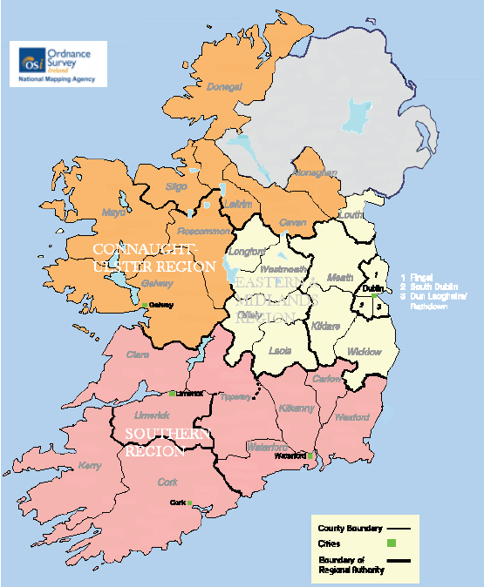
Proposed Regional Authorities and Boundaries,
Department of Environment, Community and Local Government, October 2012.
Source: Department of Environment, Community and Local Government (2012) Putting People First – Action Programme for Effective Local Government. Dublin: The Stationery Office.
Notes:
The eight regional authorities and two assemblies will be replaced by three regional assemblies to
perform an updated range of strategic functions, with a reduction in overall membership from 290
to 62.

Slide 5
Main Provisions - Funding
A more equitable Property Tax
Oversight and Audit Commission
CEO Post
Reserved Functions to Increase
Section 140 powers to be curtailed
Amalgamation of representative bodies

Slide 6
Provisions for Economic Development and Service Delivery
New Economic Development SPC
Economic Planning in County / City Plan
New Training Initiatives and Enterprise Offices
Greater Performance Monitoring and Public Information
Service Level Agreements with Government Departments
Customer Initiatives and use of ICT

Slide 7
Functions and Activities to be considered for Assignment to Local Authorities from Government Departments / Agencies
Source: Department of Environment, Community and Local Government (2012) Putting People First – Action Programme for Effective Local Government. Dublin: The Stationery Office.

Slide 8
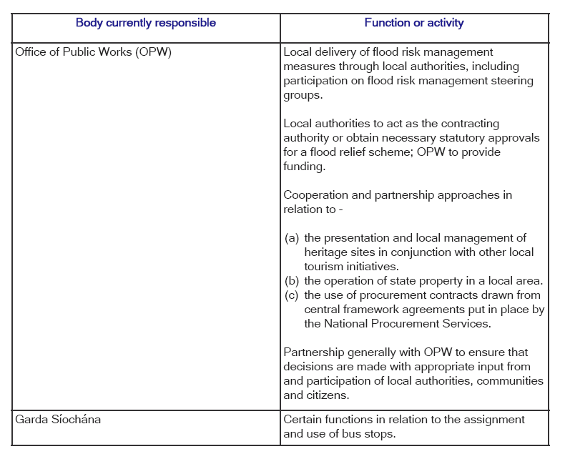
Source: Department of Environment, Community and Local Government (2012) Putting People First – Action Programme for Effective Local Government. Dublin: The Stationery Office.

Slide 9
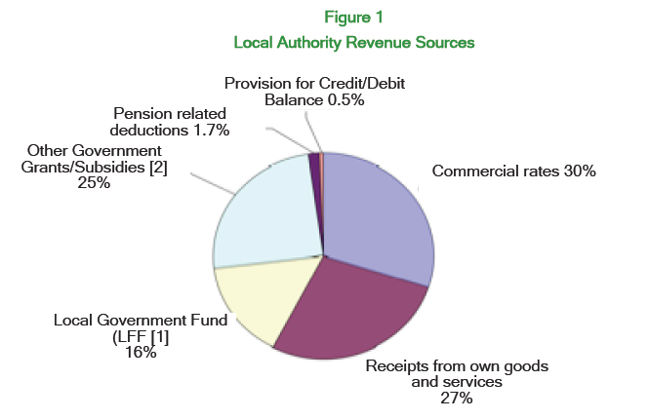
Source: Department of Environment, Community and Local Government (2012) Putting People First – Action Programme for Effective Local Government. Dublin: The Stationery Office.

Slide 10
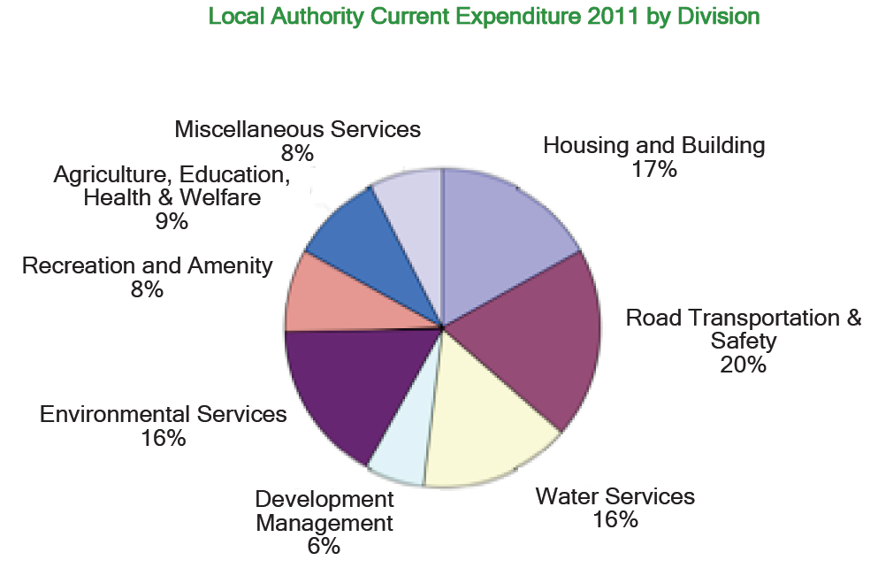
Source: Department of Environment, Community and Local Government (2012) Putting People First – Action Programme for Effective Local Government. Dublin: The Stationery Office.

Slide 11
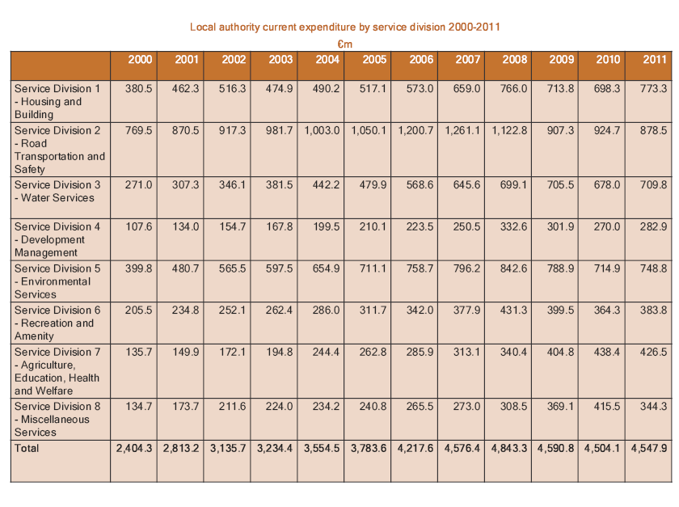
Local Authority Current Expenditure by Service Division, 2000 - 2011
Source: Department of Environment, Community and Local Government (2012) Putting People First – Action Programme for Effective Local Government. Dublin: The Stationery Office.

Slide 12
Observations
If implemented, the proposed Hogan* Reforms (2012) will result in Ireland overtaking the UK in having:
The lowest number of local authorities per capita in EU15
The largest populations per municipal authority in EU27
The weakest local democracy in respect of the number of electors per councillor.
Regional Authorities remain unelected (not directly elected by citizens) and lack enforcement powers in regional planning. The arbitrary way in which their boundaries were changed suggests top-down domination.
The focus on town and hinterland runs contrary to area-based approaches to planning, based on functional territories and networking that had been emerging in Ireland, particularly in rural areas** and sets back the implementation of the National Spatial Strategy.
Notes:
* The Minister for Environment, Community and Local Government is Mr. Phil Hogan T.D..
** Irish-based representatives of the Regional Studies Association (Van Egeraat and Foley) have asserted that the reform proposals look “very much like an ad hoc, back-of-the-envelop, exercise mainly inspired by a desire to cut government expenditure. Regional boundaries can be determined on the basis multiple grounds and there is no one-size-fits-all solution. But they should be established on an evidence-based logic… [and] in relation to the boundaries of the new Regional units, the new system is a step backwards for regional development.” (Van Egeraat, C. and Foley, R. (2012) New Irish Regions Announced. Statement released via Regional Studies Association – Irish Branch, 16th October 2012).

Slide 13
Commentary
Potential for Local Authorities to become more independent in raising revenue
Populist – cuts down on public expenditure
Reduces democratic input – fewer councillors and larger authorities, although district tier within counties may represent potential planning and development spaces
Abolition of Town Councils removes the only equivalent of municipalities / communes
Departs from regional planning principles and Mahon Tribunal recommendations
Becoming more like UK and less like Mainland Europe

